Slide 1
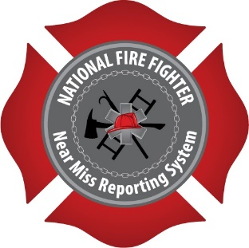
2017 Fire/EMS Safety and Health Week
Preventing the Mayday

Slide 2
Preventing the Mayday
Fire fighters/EMTs can help prevent Mayday situations by focusing on six categories:
Maintain Situational Awareness
Hazard Assessment and Identification (pre-planning)
Size-Up the Incident
Air Management
Maintain a Healthy Fitness Level
Understand Defensive Operations

Slide 3
Situational Awareness
Situational Awareness (SA) is defined as being aware of how your actions can impact the overall operational goals and objectives during an incident, both during the time your actions will be occurring and in the proceeding future.
Lack of situational awareness is consistently the highest contributing factor in Near-Miss Reports.
“To the Incident commander, Fire Officer or firefighter, knowing what’s going on around you, and understanding the consequences is mission critical to incident stabilization and mitigation and profoundly crucial in terms of personnel safety.”
Christopher Naum
Buildingsonfire.com

Slide 4
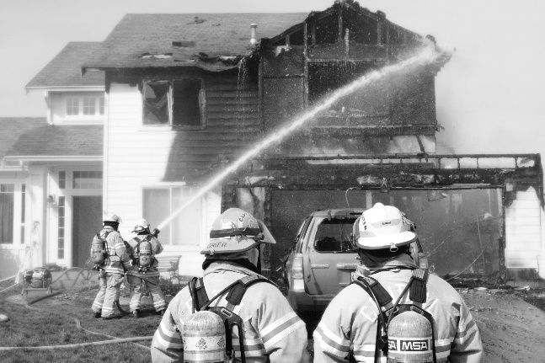
Situational Awareness Near Miss Yesterdays lesson still relevant today
“We were the first engine on arrival at a structure fire with heavy smoke showing from a large commercial ordinary construction (brick and stick) structure…The commercial structure was vacant and boarded up…forced entry into the store front doors of the building and advanced a 1 3/4 handline…After advancing into the structure several feet with zero visibility another company on the scene pulled off the boards that sealed the front display windows of the vacant commercial occupancy. This provided the fire the oxygen it needed and fresh air to suddenly ignite the entire interior of the building with us inside…”

Slide 5
Planning
Pre-plans allow members to understand and identify hazards at a location before they respond to an emergency.
Pre-plans need to be completed objectively, consistently and accurately.
Indexing of plans in an accessible database ensures easy access by all members.
An annual review of plans should be conducted for validity and reliability.

Slide 6
Planning
Pre-planning is the process of gathering and recording information that could be critical for emergency personnel on an incident involving a specific occupancy.
Pre-plans can assist in hazard assessment and hazard identification improving safety and wellness for firefighters.
A thorough pre-plan process can greatly reduce the risk of injury and/or death to firefighters.

Slide 7
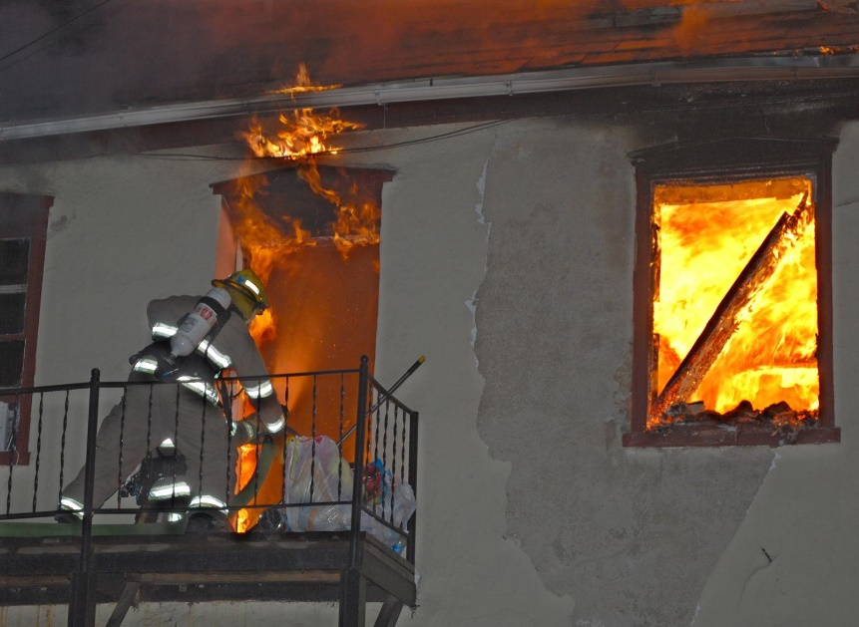
Planning Near-Miss Firefighter falls thru skylight
“…After reviewing the incident and looking at some of the other buildings in the complex, it appeared that I actually fell through a 2ft x 4ft skylight/atrium …I fell through a hole that I did not know was there and could not see. It might have been prevented with better knowledge of pre-plans. I have been responding to this complex for 10 years and never noticed the small atriums.”

Slide 8
Size-Up
An incident size-up is a critical step that needs to be conducted upon the arrival of units and continually throughout an incident.
Information such as, but not limited to, exposures, hazards, volume of fire, location of victims, and general layout of the structure can greatly increase operational efficiency and safety.
All members of a crew should conduct their own size-up and relay information that they think is critical to maintaining safety on the fire ground at all times.

Slide 9
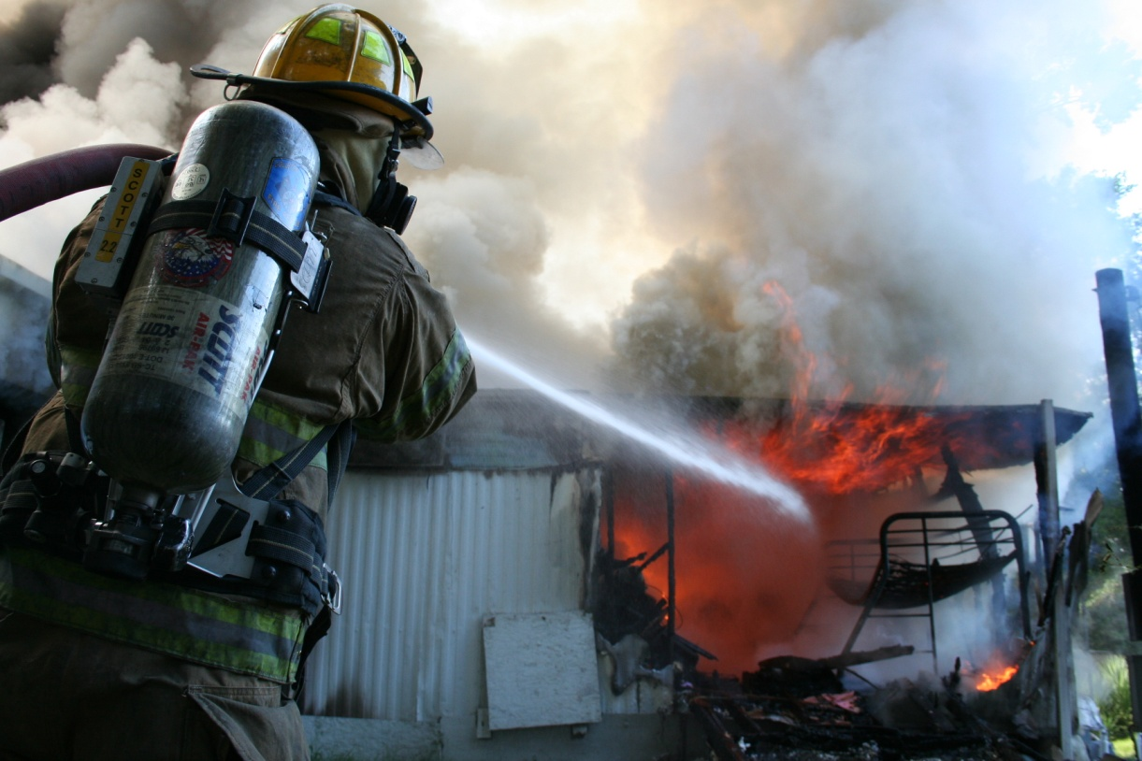
Size-Up Near Miss Engine crew flanked by hidden fire
“The first engine crew was advancing on the fire when a false wall behind them burnt through…A proper size-up was never completed by all companies working on the scene. The back-up line that the second engine pulled was a 1 ¾” and did not match the initial 2 ½” attack line. The first engine should have realized what the conditions were and that they were rapidly deteriorating before advancing as far as they did.”

Slide 10
Air Management
Personal air management is incumbent upon you for your own safety.
It is important to understand your individual consumption rate and limitations of your SCBA.
Once your low air alarm is activated, it’s time to exit the structure.
Never continue to operate while under a low air alarm.

Slide 11
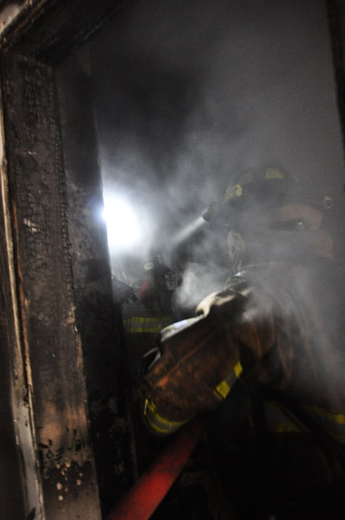
Air Management Near Miss Captain remains within structure after low air alarm is sounded
“The crew advanced a 1.75” line to the basement and found heavy smoke conditions with relatively low heat…The Captain’s low-air alarm sounded but he decided to continue searching…the Captain ran out of air. He unsealed his mask and took a total of two breaths at the floor level before he was able to exit the basement…we are developing an air management policy that will eliminate the practice of "work until your low-air alarm activates".

Slide 12
Fitness for Survival
Fire fighting is inherently an extremely demanding job, both physically and mentally.
Fire fighters need to exercise on a regular basis in order to operate in a safe and efficient manner.
In 2010, 60% of fire fighter deaths were caused by heart attacks or strokes (USFA).

Slide 13
Fitness for survival
Fire fighting is inherently an extremely demanding job, both physically and mentally.
Fire fighters need to exercise on a regular basis in order to operate in a safe and efficient manner.
In 2010, 60% of fire fighter deaths were caused by heart attacks or strokes (USFA).

Slide 14
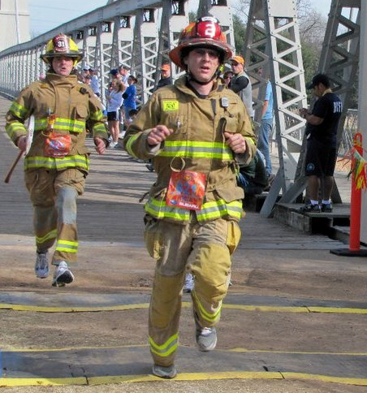
Fitness for Survival Near-Miss Incident Commander of an apartment fire suffers heart attack
“While working as the Incident Commander of an apartment fire, I suffered "Sudden Cardiac Death”…I underwent a 4-way open heart bypass operation two days later. A couple of months after that, I went through a cardiac stress test and echocardiogram. Those tests revealed that I had no heart damage and was completely healed...Since that day I have quit smoking, started eating a much more heart healthy diet and exercise 4 to 6 days a week. I firmly believe in fire-based EMS and firefighter physical fitness.”

Slide 15
Defensive Operations
Incident Commanders need to have the self courageous leadership to switch to defensive operations when conditions rapidly deteriorate endangering fire fighter’s lives.
Ensure all interior personnel are out of the structure before operation of exterior Master Streams.
Maintain accountability to prevent freelancing.
Ensure structural stability before re-entering structure .
“We will risk a lot to save a lot, We will risk little to save little, We will risk nothing to save nothing.”

Slide 16
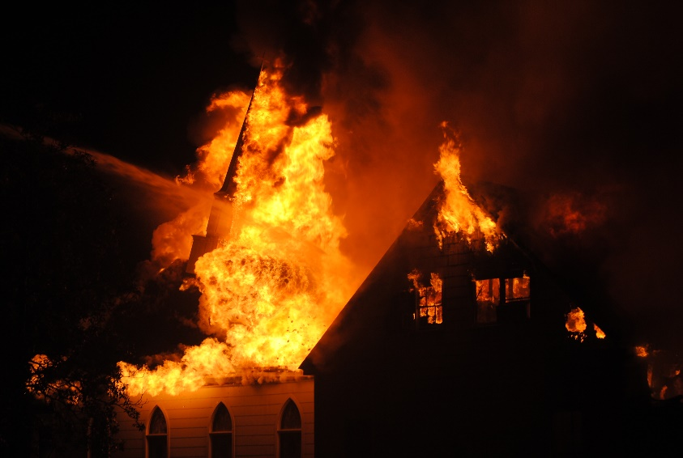
Defensive Operations Fire in church traps several firefighters. Multiple maydays called
“…On investigating E1 reported working fire on second story and was stretching a line to attack fire… At 2 minutes in ,command advised that smoke condition had changed, and warned interior crews that they possibly had a "well charged attic". ..At approx 4 min in E2 reported fire at an exterior porch and ceiling starting to come in on the north side…At approximately 8 minutes in, units were not reporting any progress and command was debating a switch to defensive operations. At this point a total of 3 maydays were transmitted by interior crews with members lost and off of hose lines…”

Slide 17
Activity
Read the following Near-Miss Report:
Fire in church traps several firefighters. Multiple maydays called
Discuss the following as they relate to this report:
Consider the size of the structure in relation to smoke and fire conditions
Proper crew management/accountability
Should a Mayday had been called?
Could a pre-plan of this structure prevented the near-miss?
When should you switch to defensive operations?

Slide 18
Near-Miss Report Fire in church traps several firefighters. Multiple maydays called
“Units responded to automatic alarm at church. While enroute, incident was upgraded to full alarm assignment on reports of fire in the "red brick" building. First alarm assignment consisted of Q1, E1, E2, E3, E4, B1. Q1 and E1 arrived 1st with nothing visible from large church. Q1 took command and positioned on the south side, and E1 positioned on the North-side. On investigating E1 reported working fire on second story and was stretching line to attack fire. Approximately 1 minute after arrival command requested 2nd alarm and sent Q-crew in to assist with evacuation and investigation. At 2 minutes in command advised that smoke condition had changed, and warned interior crews that they possibly had a "well charged attic". E1 acknowledged and proceeded to attempt to locate and extinguish a fire located in 1 room (per radio report)…”

Slide 19
Near-Miss Report Fire in church traps several firefighters. Multiple maydays called
“…At approx 4 min in E2 reported fire at an exterior porch and ceiling starting to come in on the north side. As B1 arrived and assumed command, radio time was hampered with the request for additional resources such as police and our laundry list of things. At approximately 6 minutes in we had approximately 3 big boosters and 1 super booster operating. Units on the interior were requesting more pressure. At approximately 8 minutes in, units were not reporting any progress and command was debating a switch to defensive operations. At this point a total of 3 maydays were transmitted by interior crews with members lost and off of hose lines. E1 firefighter ended up outside the building and was out of air. His lieutenant was left in the building. At this point the decision to go defensive was made, and all members were ordered out. E2, knowing the situation, decided to stay and was able to find E1 lieutenant, who was lost and low on air. All companies were able to exit and after a large aerial assault the fire was brought under control.”

Slide 20
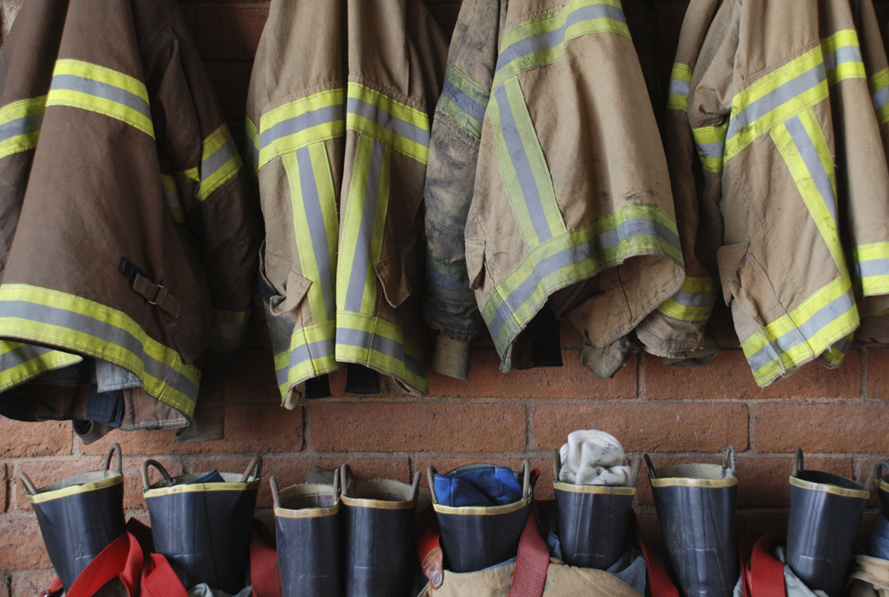
Protect the next shift . . .
QUESTIONS?
SHARE YOUR
STORY.
International Association of Fire Chiefs
Firefighter Near Miss Program
NearMiss@IAFC.org
www.FirefighterNearMiss.com

